Slide 1
GROUP 7: DATA ANALYSIS AND VISUALIZATION
Info 7250: Big data architecture and governance
Electronic products catalog

Slide 2






























Project & Team Info
Project Documents
No-SQL Database
Data Cleaning
Power BI Connection
Data Visualization & Inference
Issues Faced & Conclusion

Slide 3
WHAT’S OUR PROJECT ABOUT?
WHAT'S IT ABOUT: This dataset contains a list of over 15,000 electronic products with pricing information across 10 unique fields provided by Datafiniti's Product Database.
The aim of the project is to provide inference from the given data through data analysis and visualization and to document the entire process of it.
Deliverables: 1) Project Presentation
2) Power BI Dashboards
3) Business Glossary
4) Supporting Documents include Database Connection, Power BI Connections
and Issues Documentations

Slide 4




OUR TEAM
Astha Rastogi
Role: Project Manager
-Worked on team coordination activities
Eric Pozholiparambil
Role: Data Analyst
-Cleaning data in python and analyzing the data trends
Ankita Roy
Role: DBA
-Helped in installation of Mongo DB and its dependencies.
Shweta Pathak
Role: BI Developer
-Curated powerful visualizations in Power BI

Slide 5

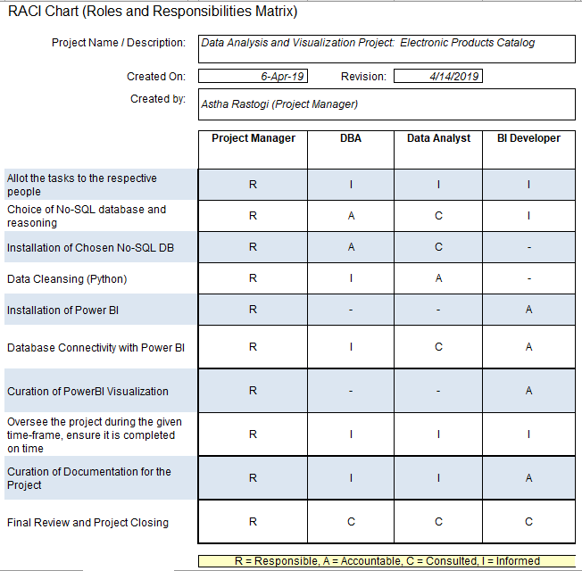



RACI MATRIX

Slide 6
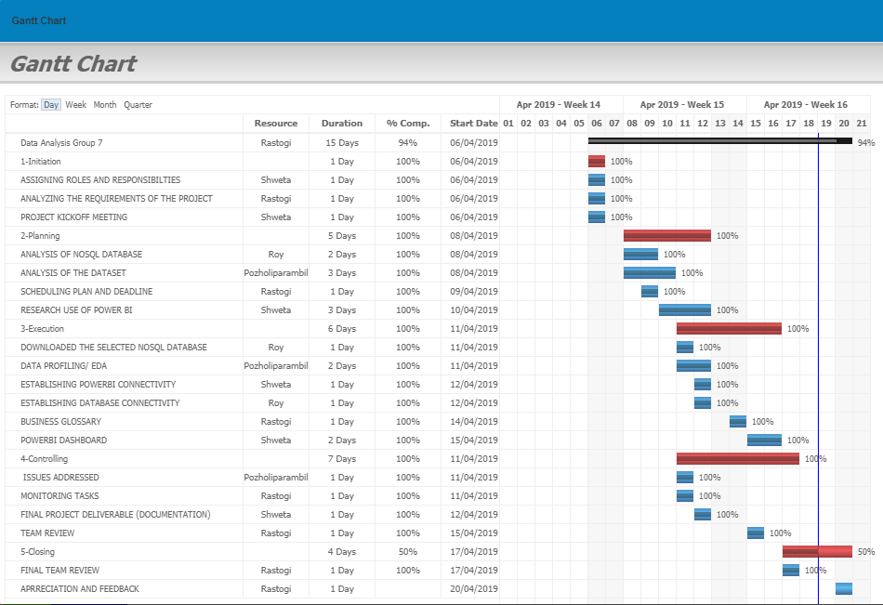
GANTT CHART

Slide 7

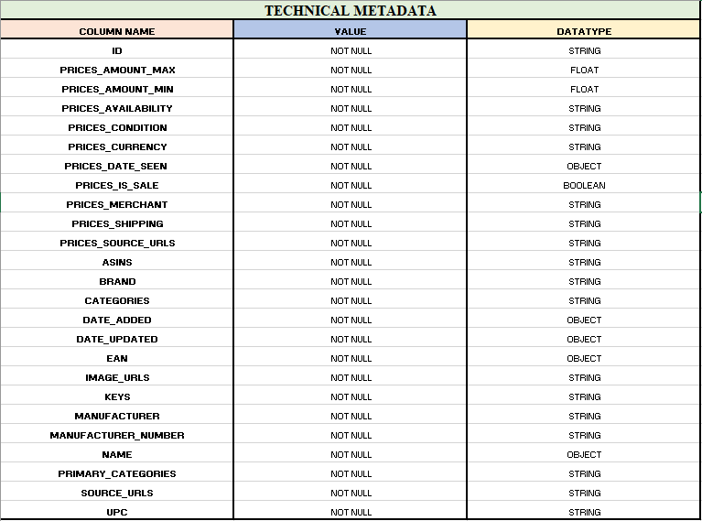
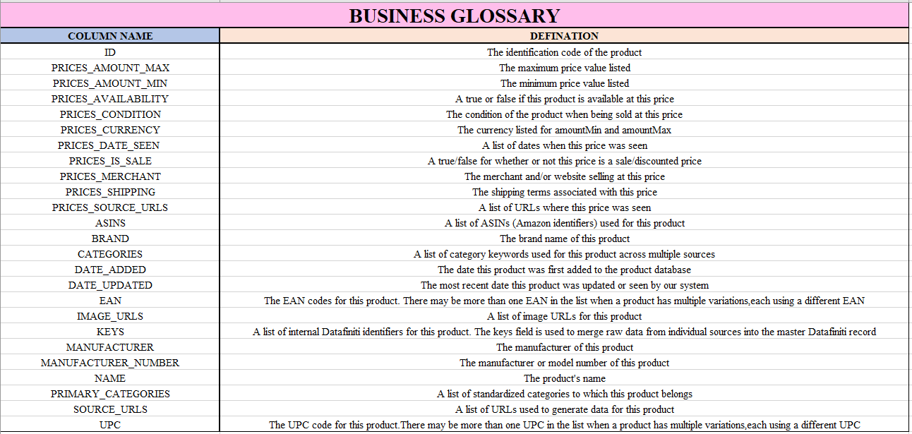
BUSINESS DOCUMENTS

Slide 8
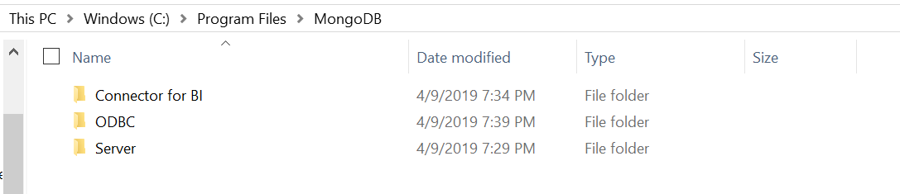
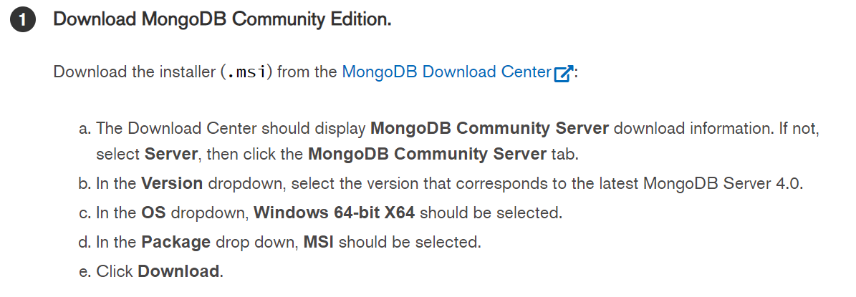
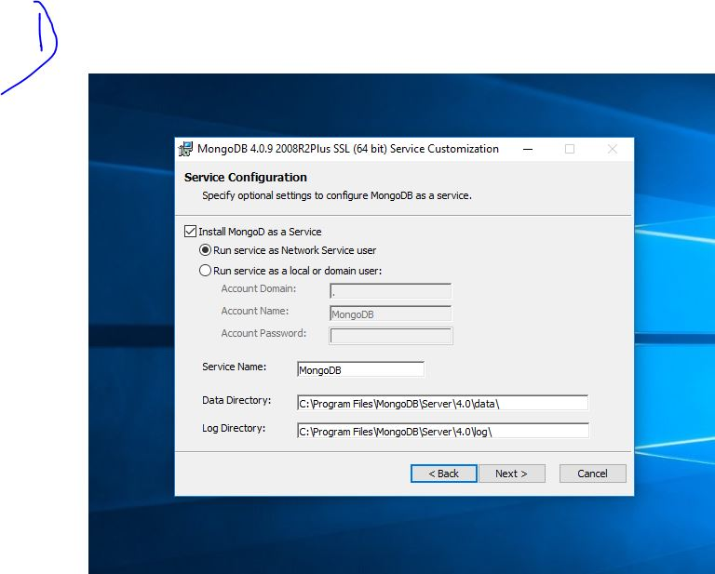
STEP-1ANALYSIS & INSTALLATION OF NO-SQL DATABASE
It is important to have all 3 of these components
Chosen Database: MongoDB
Criteria:
Easy to install and setup
Documentation available
Very easy to scale and is schema-less
Professional support available
Documentation and Download link: https://docs.mongodb.com/manual/administration/install-community/

Slide 9
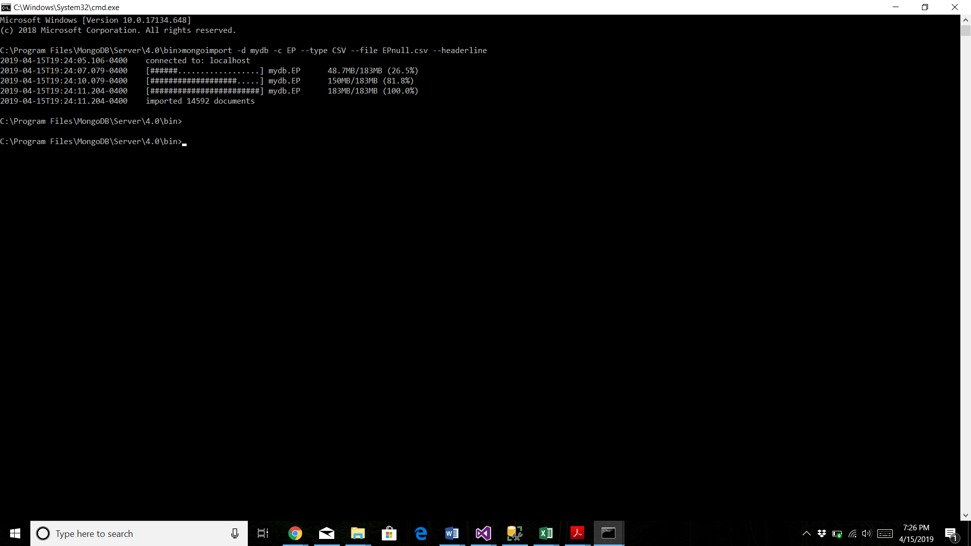
STEP-1: INSTALLATION OF NO-SQL DATABASE
This command helps us build the database by mentioning the name of the database and its type which in our case is csv.
Imported the number of rows that we have in our csv which clearly shows that the command is successful.

Slide 10
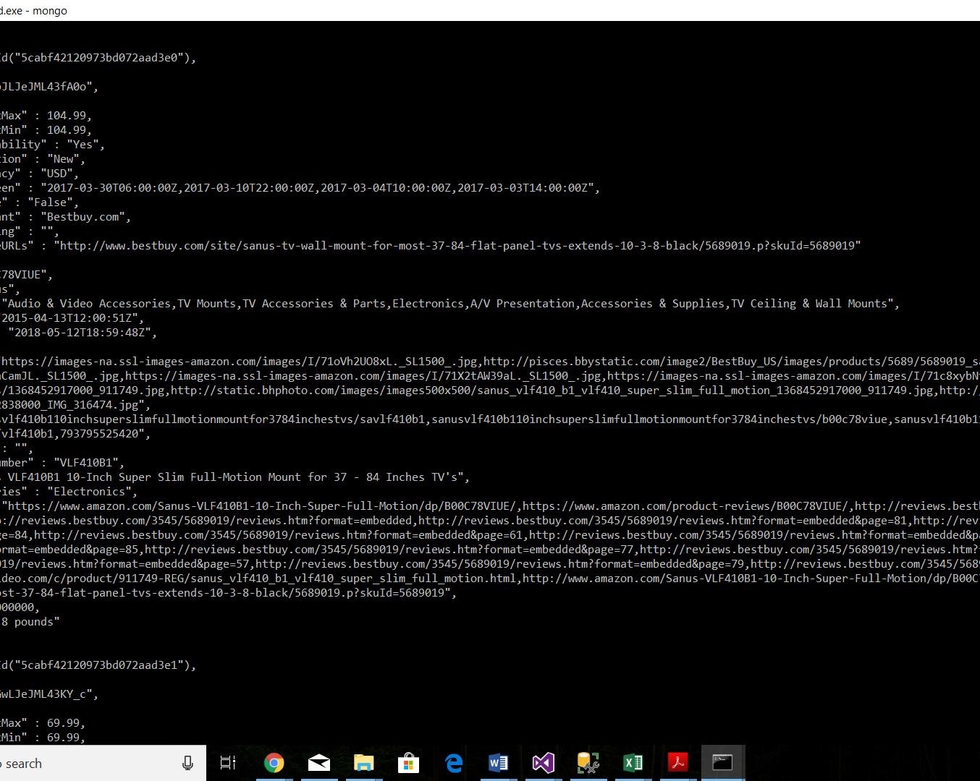
In order to test if our installation was correct and if we fed the right data, we displayed the data on the command prompt using the command: ‘ Show mydb’

Slide 11
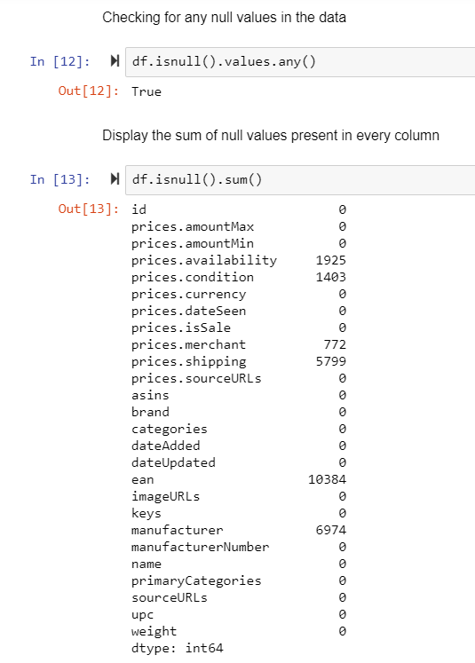
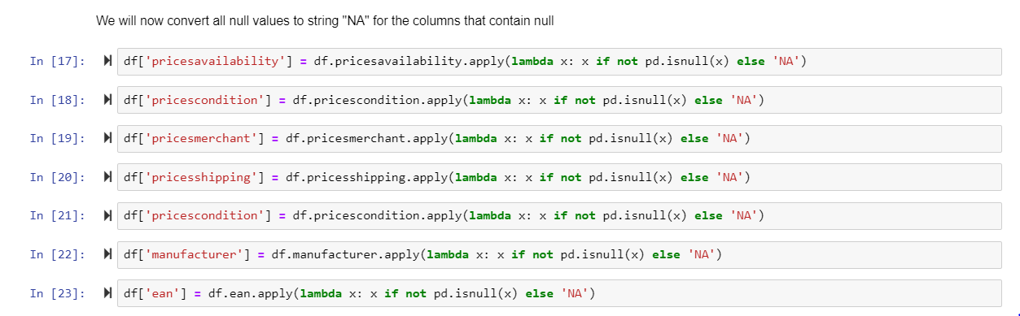
STEP-2: DATA CLEANING
After importing the source data, we checked if there are any null values present and if yes then which columns have them.
We handled the null data since we didn’t want to lose any important data from the data set.

Slide 12
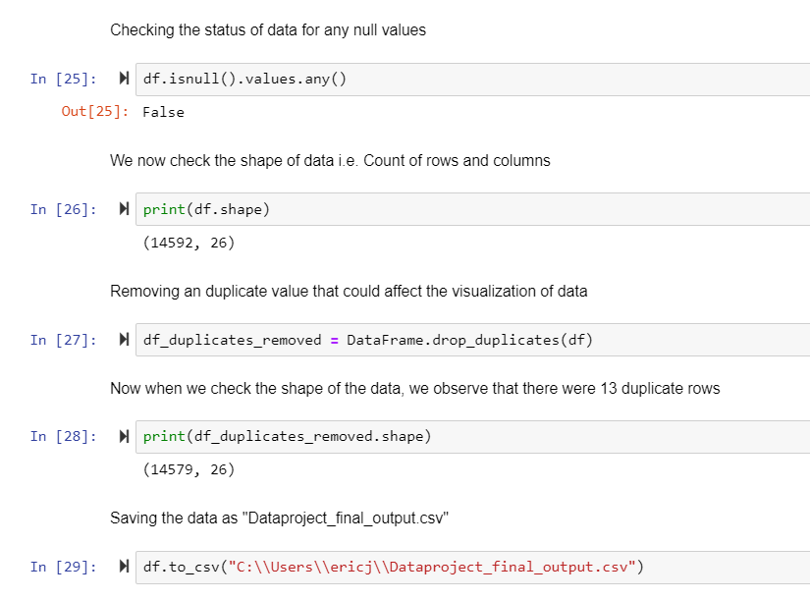
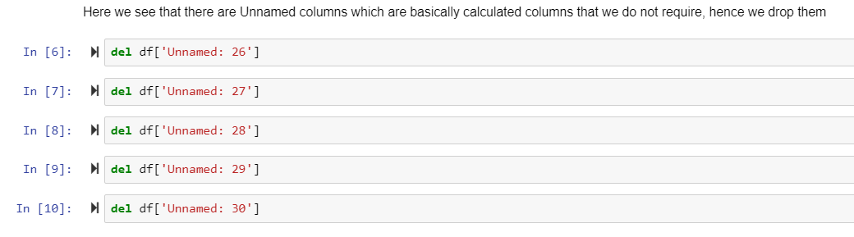
STEP-2: DATA CLEANING
Checking for duplicates and handling them.
Inconsistency in the data was found and handled.

Slide 13
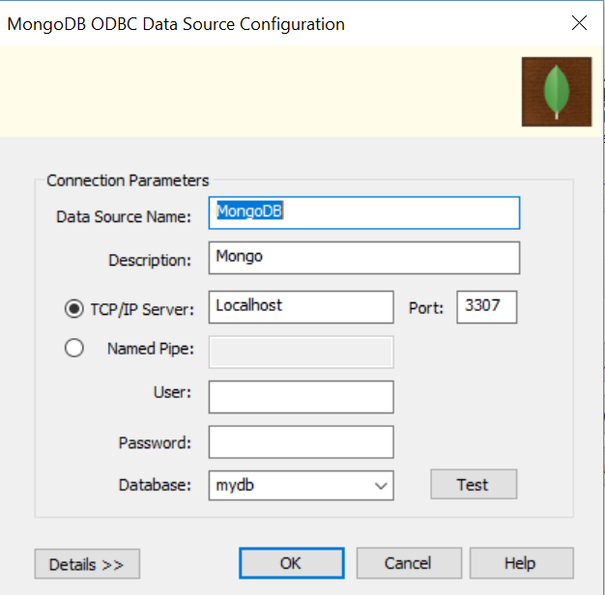
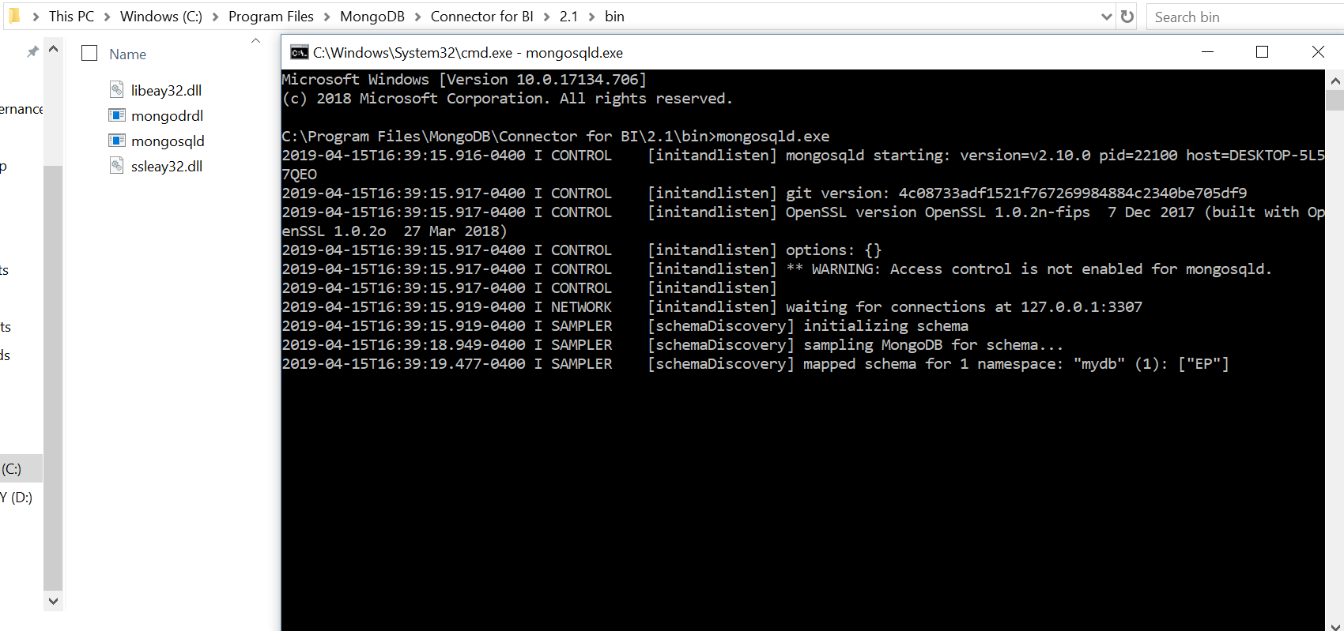
STEP-3(a): CONNECTING NO-SQL DB TO POWER BI
Port 3307 is for the BI Connector for Mongo DB
We already have created the database which becomes visible here.
After downloading the dependencies (ODBC Driver and BI Connector), the ODBC Driver needs to be configured for MongoDB.
For this, run the command prompt in the BI Connector for Mongo DB folder which opens the port 3307 for connection.
This is the BI Connector which needs to be running behind.

Slide 14
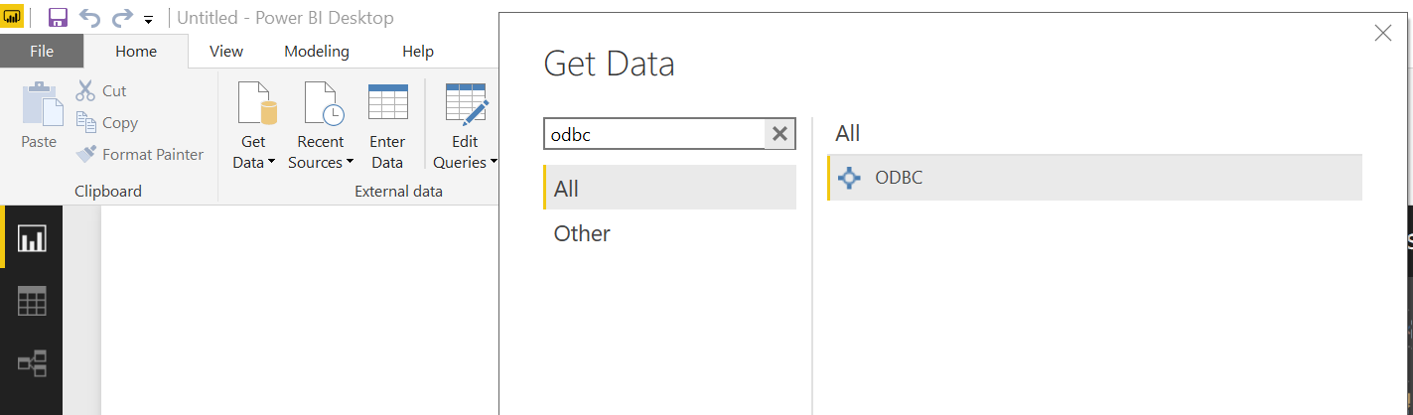
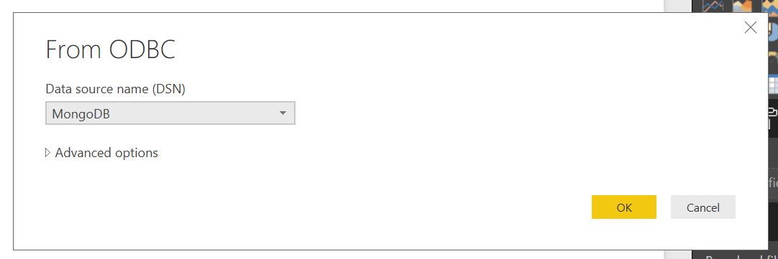
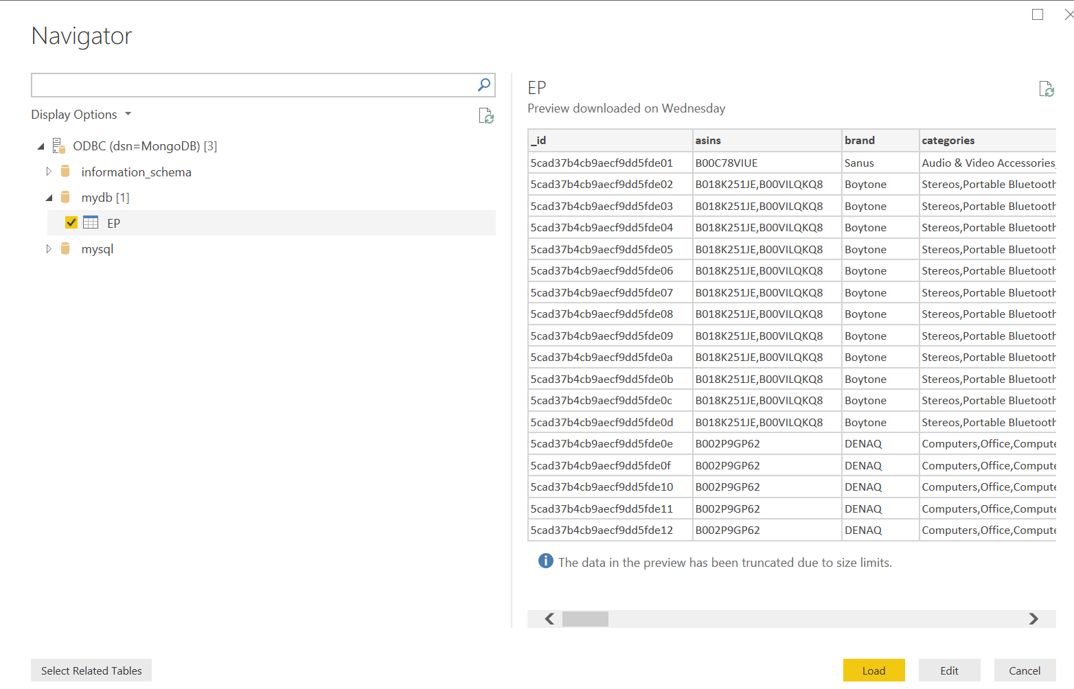
STEP-3(b): CONNECTING NO-SQL DB TO POWER BI
Choosing the ODBC Connector that we just created.
The next steps involve connecting the ODBC connection to Power BI.
After opening Power BI, click on ‘Get Data’. From all the available options, choose ‘ODBC’.
Once the ODBC Dialog box opens, choose the connector that was created in the last step.
Data preview is visible once you select the database (Here ‘mydb’)

Slide 15
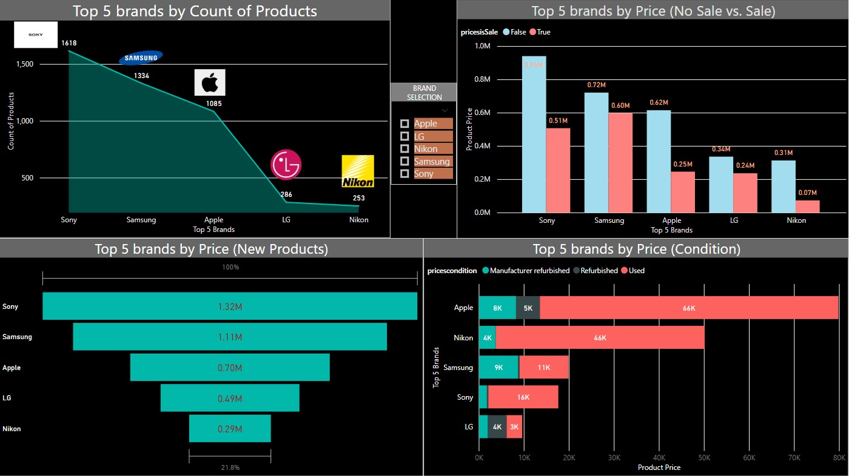
STEP 4: POWER BI VISUALIZATION
DASHBOARD-1

Slide 16
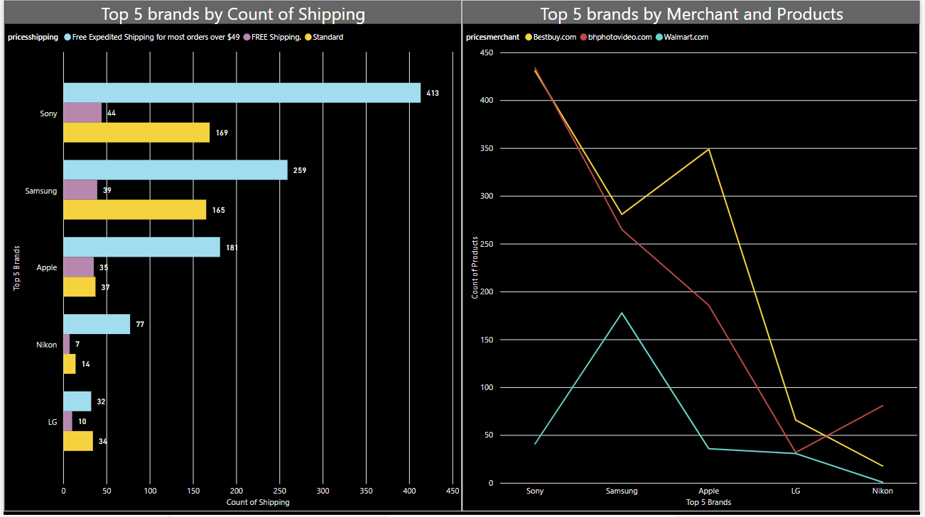
STEP 4: POWER BI VISUALIZATION DASHBOARD-2 DASHBOARD-1

Slide 17
STEP-4: INFERENCE OF THE DATA
The data contains Electronic Products been sold based on
Whether the product is on sale or not
Whether the product needs to include shipping cost or not
Whether the product is used or not (condition)
We can thus infer that by the count of products ‘SONY’ ranks the first and it sells maximum products which are ‘Not on Sale’ with ‘Expedited Shipping’ benefit.
Amongst the top 5 brands, ‘Samsung’ sells the highest count of products which are ‘On Sale’ while ‘Nikon’ sells the least.
In terms of merchants, ‘Best Buy’ ranks the highest with selling maximum products for the top 5 brands.

Slide 18
ISSUES FACED AND ADDRESSED:
Database Choice
Database to Power BI Connection
Data Interpretation
Visualization on the given data
ODBC Connectors

Slide 19
THANK YOU
FEEDBACK APPRECIATED.
ANY QUESTIONS?

